Slide 1
Phishing Emails: Tips for recognizing and avoiding them

Slide 2
Objective
Inform and increase the awareness of all MemorialCare employees, volunteers, physicians and students of the dangers and threats imposed on MemorialCare as a result of “phishing” emails.
Instruct personnel on how to recognize these email threats and what to do if you suspect that an email is not legitimate

Slide 3
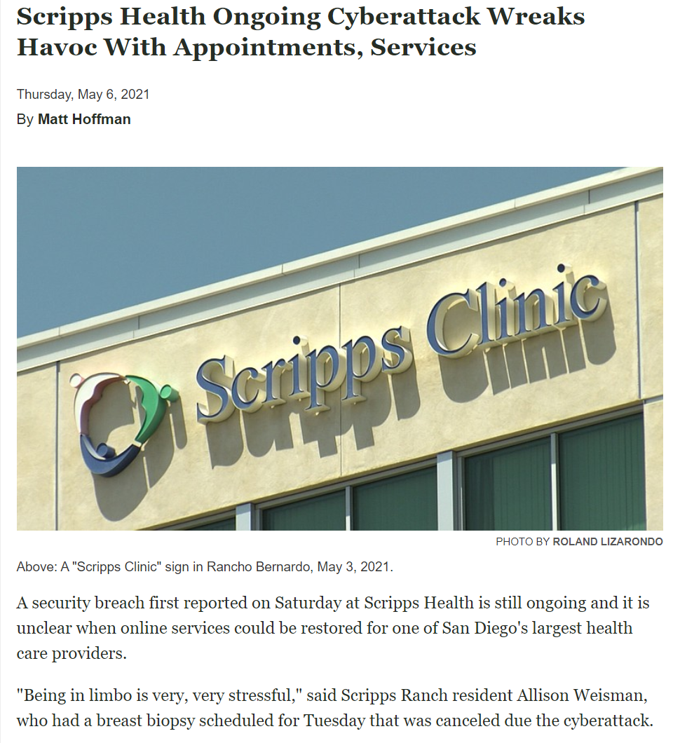
Why is this important?

Slide 4
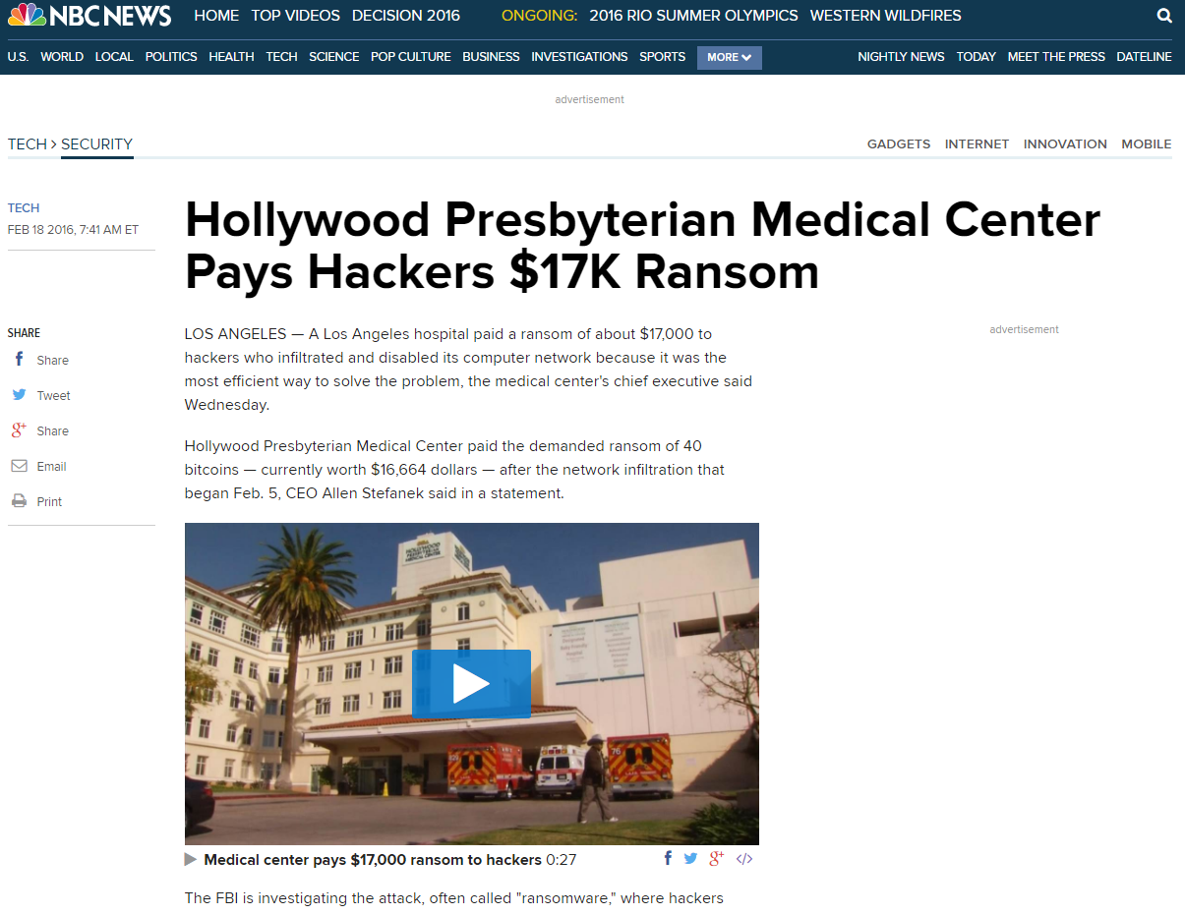
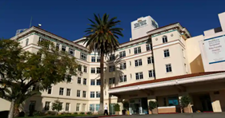
Why is this important?

Slide 5
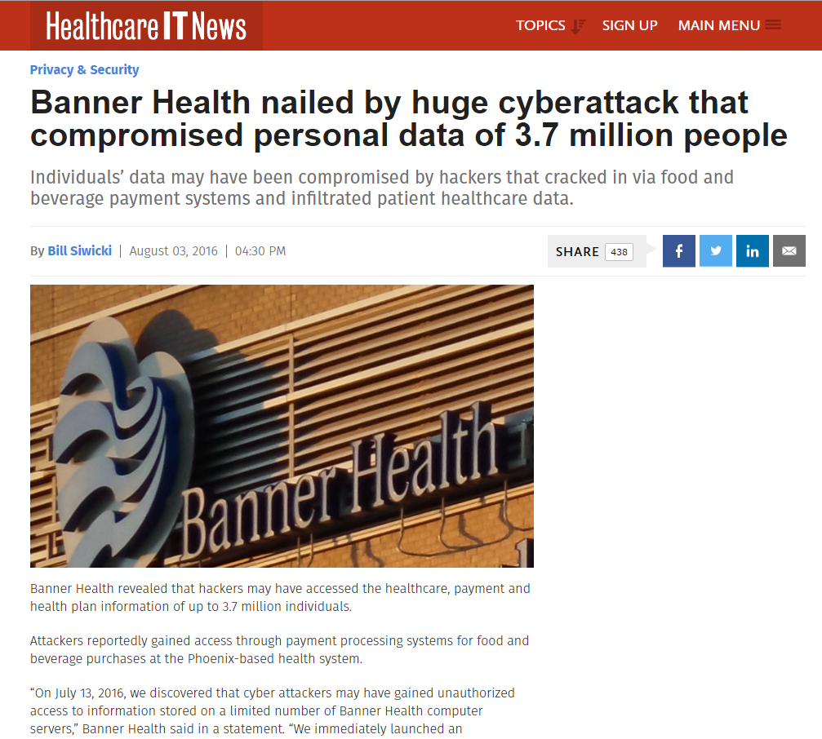
Why is this important?

Slide 6
Phishing Definition
Phishing: A criminal activity using social engineering techniques to manipulate people into performing actions or divulging confidential information to fraudulently acquire sensitive information, such as usernames, passwords and credit card details by masquerading as a trustworthy entity in an electronic communication.

Slide 7
Threats of Phishing
Obtaining your personal information
Gaining access to patient, employee and company information
Locking or controlling critical computers or devices used in patient care (i.e. Epic)
Reputational and financial harm to MemorialCare

Slide 8
Recognition
Warning signs of a phishing email:
1) Generic Greeting
2) Unfamiliar Sender Address
3) Sense of Urgency
4) Fake/Deceptive Web Links.
Email is requiring that you follow a link to sign up for a great deal, or to log in and verify your account status, or encourages you to view/read an attachment.
5) Emails that appear like a website
6) Misspelling/Bad Grammar
7) Asking for username and password
8) Unsolicited/suspicious email from coworker with link or attachment (spreadsheet, Word document, PDF file) asking you to open click or open

Slide 9
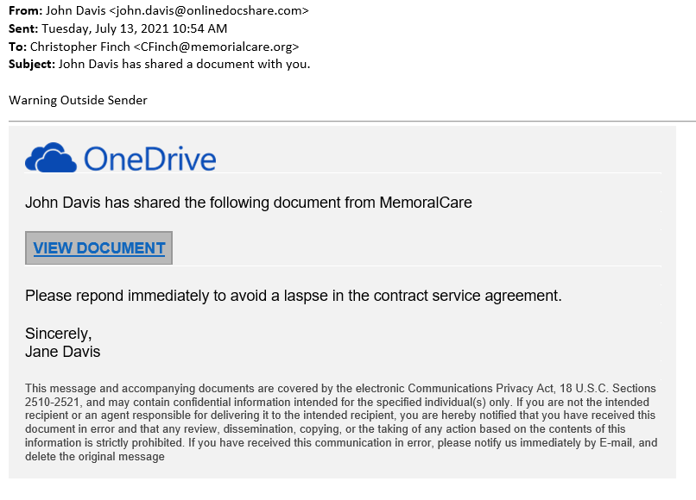
Recognition (Example)
Unknown Sender
Misspellings
Sense of urgency
Signed Jane Davis not John Davis

Slide 10
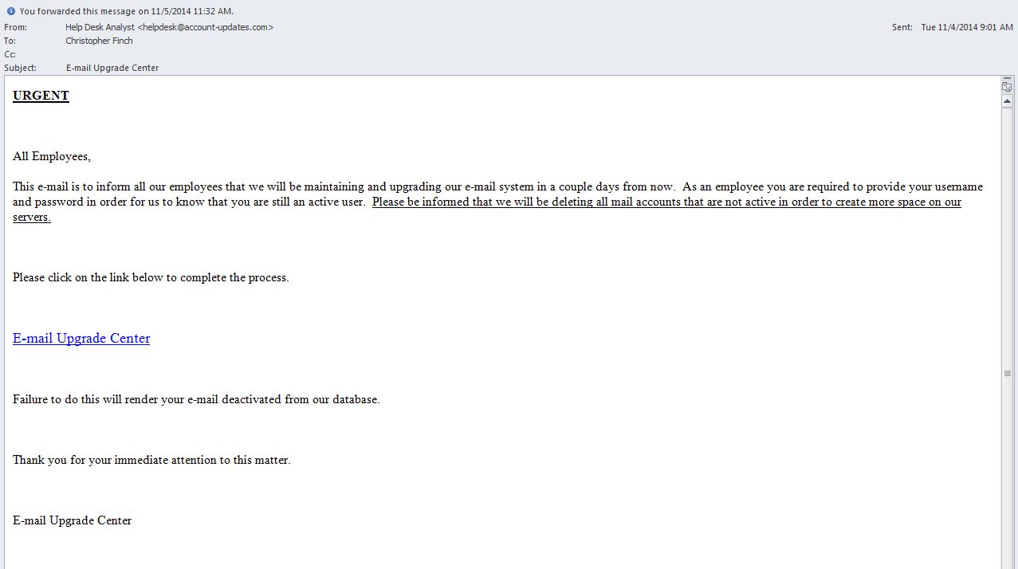
Recognition (Example)
Not a MemorialCare email account
MemorialCare will never ask for your password
Creates urgency for reply

Slide 11
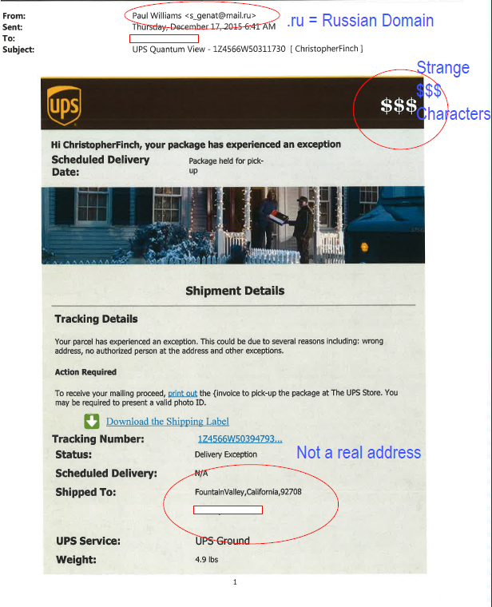
Recognition (Example)
Real phishing email from Russia
Things to look for

Slide 12
How do hackers gain access??
Reconnaissance
Hacker learns about ABC Company using social media (Google, LinkedIn, etc.)
Determines who key employees are and their contact information (email addresses)
Phishing Email
Using information gathered from social media, hackers create a phishing email that looks like an email the recipient would receive. The email does not ask for any personal information only to click on a link
Phishing email is sent to identified individuals in ABC Company
Access to ABC Company Network
Initial access to the company network is achieved when a person with the right user credential clicks on the link
Outcome-
Hacker is able to breach ABC Company’s network within days and traverse ABC Company’s network undetected and gain access to most all systems and applications including Protected Health Information (PHI) and sensitive information
Initial access was gained through a simple phishing email and mouse click resulting in harm to ABC Company

Slide 13
Tips
Limit use of company email to business purposes only
Avoid using memorialcare.org email for shopping, chain emails, or forwarding interesting or amusing emails to coworkers.
If you’re not sure it’s a phishing email, notify MHS Service Now by clicking the PhishAlarm button to report the email. They will let you know if it is a legitimate

Slide 14
Tips
Never enter your MemorialCare username and password
Don’t open email attachments or click links:
From someone you do not know
From someone you know, but weren’t expecting an email from (infected computers can send malicious emails from the owner of the computer to everyone in their email address book)
This is especially true if the content of the email message is brief, vague, and/or unusual
Don’t rush through emails. If you are being asked to act (I.e. Open, Sign etc.) take an extra minute to review the email for warning signs described in this training

Slide 15
Almost finished
Thank you for your attention regarding
this important matter.
Understanding the threat not only protects MemorialCare,
but also your own personal information
from cyber criminals.
Continue to the next page for instructions to complete this training.
For Questions, please contact:
MHS Service Now at 562-933-9450

Slide 16
You have one more step to complete this training
You have finished the Learning portion.
To complete the training:
Ctrl + Click on this link to be taken to the Attestation.
The Attestation is your acknowledgement that you have read and understand the training content.
The training is not complete until you have responded to the Attestation.

